Slide 1
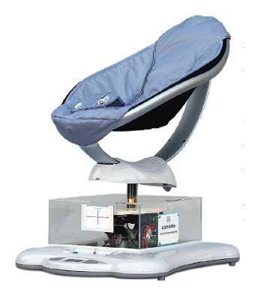
Dossier ressources
ILOT MOBY CREA

Slide 2
ILOT CORDEUSE

